Slide 1
LINQ to SQL

Slide 2
What are we going to do today?
What is LINQ to SQL?
Database Models
Data Context
Examples

Slide 3
What is LINQ to SQL?
LINQ to SQL
A technology that takes maps Relational Databases to object code (.NET classes)
Use LINQ to query these new objects
Fully supports transactions, views, stored procs, tables and all the SQL integrity logic that tables and relationships use

Slide 4
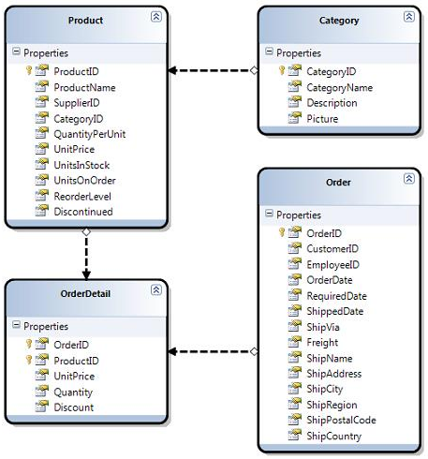
Database Models
Using SQL Server, you can create Database Diagrams to facilitate easy creation of tables and logic

Slide 5
Data Context
Data Modeling Visual Studio
Visual Studio also allows you to take (and create for that matter) the visual Database Diagrams from your SQL database and ‘drop and drag’ them from Diagram to Context
Known as the DataContext

